Slide 1
Waters of the United States
Polling Presentation

Slide 2
An overwhelming majority (71%) say EPA should work with Congress and local business owners to draft a new rule that protects the environment and the economy
Over half say water quality should be regulated by state or local government
Majority of voters say businesses that directly utilize land should be trusted to make the right environmental decisions
Overwhelming agreement it is possible to protect the environment while also protecting American jobs and businesses
Strong majorities predict WOTUS would cause business operation costs, as well as consumer food and electricity prices to increase.
Methodology:
Morning Consult, on behalf of the Waters Advocacy Coalition, conducted an online survey of 1,993 registered voters from September 26 – September 28, 2017. Results from the full survey have a margin of error of +/- 2%.
Key Points

Slide 3
There is a Middle Ground, and Voters Want It
Messages are extremely effective at decreasing support for WOTUS overall, though voters still support the rule by a 7-point margin on the second ballot. However, support for re-writing the rule is strong
71% agree the EPA should work with Congress and local business owners to draft a rule that protects the environment and the economy
Provide Examples of WOTUS Representing Government Overreach
When given a multitude of issues, the largest share of voters say they are concerned whether they can trust government to act in the public interest (88% concerned). This indicates a substantial distrust in government that crosses demographic barriers, including party, age and income.
Furthermore, when given examples of how WOTUS would impact farmers specifically (that under WOTUS, a farmer would be required to get a permit to plow land, change a field from one crop to another), strong majorities say these are instances of government overreach. It is likely parallel examples from small business owners, utility companies, other stakeholder groups, etc. would inspire a similar reaction. Coupled with the stated distrust in government, concrete examples of WOTUS overreach allow voters to understand an otherwise complicated issue.
WOTUS is Too Broad, Complicated and Americans Deserve Better
For the likely the same reasoning above (distrust in government at all-time high), the following message was second most effective:
“The 2015 WOTUS rule was too vague. Americans deserve common-sense rules that don’t require teams of consultants and lawyers to navigate a federal maze of regulations.”
WOTUS Will Lead to Increasing Food and Electricity Costs
Strong majorities say they are concerned with the following:
The cost of everyday goods my family relies on (83%)
The cost of food (80%)
The cost of electricity (75%)
WOTUS Was Never Implemented, and Voters Still Satisfied with Water Quality
Majority (53%) say water quality in U.S. is good or excellent- and that is without WOTUS. Furthermore, the only message to out-perform the ‘1/3 of U.S. drinking water will be polluted’ is this: “Because the WOTUS rules never went into effect, it has no effect on the quality of drinking water as it stands today.”

Slide 4
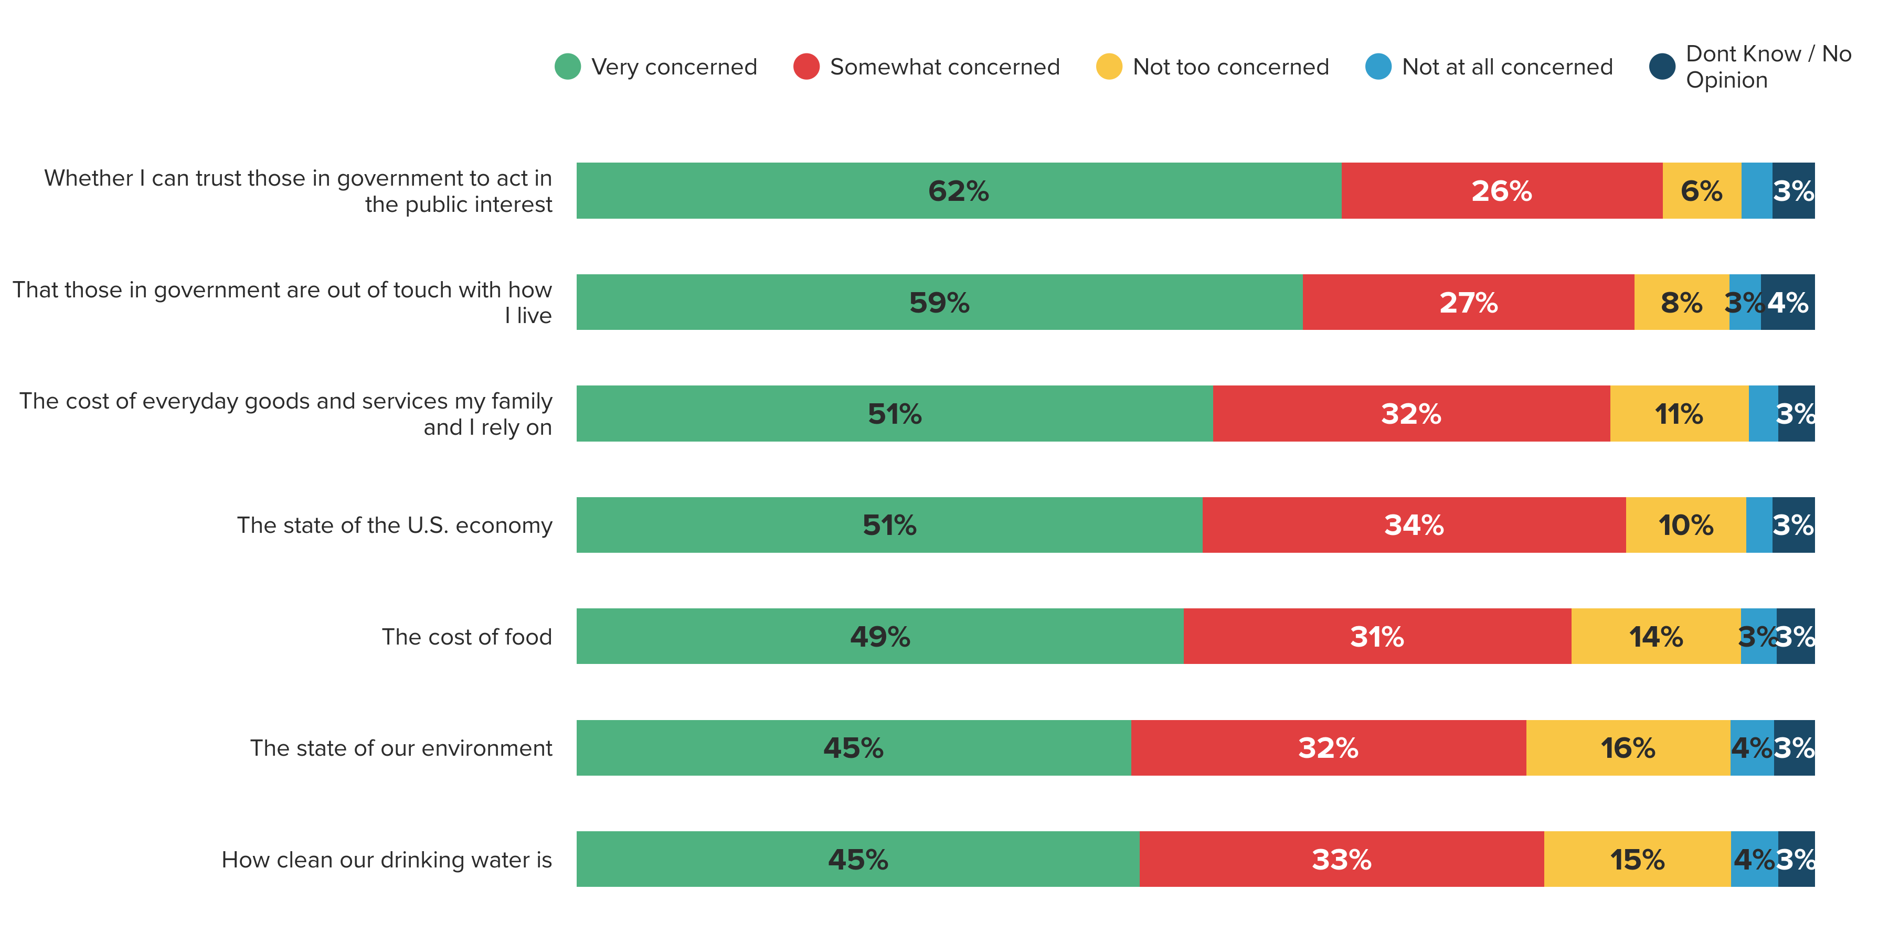
When asked to rank issues related to public policy and policy makers, voters say they’re most concerned with government’s relationship
with those they serve.
How concerned are you, if at all, about the following issues?
Total Concern
88%
86%
83%
85%
80%
77%
78%
1

Slide 5
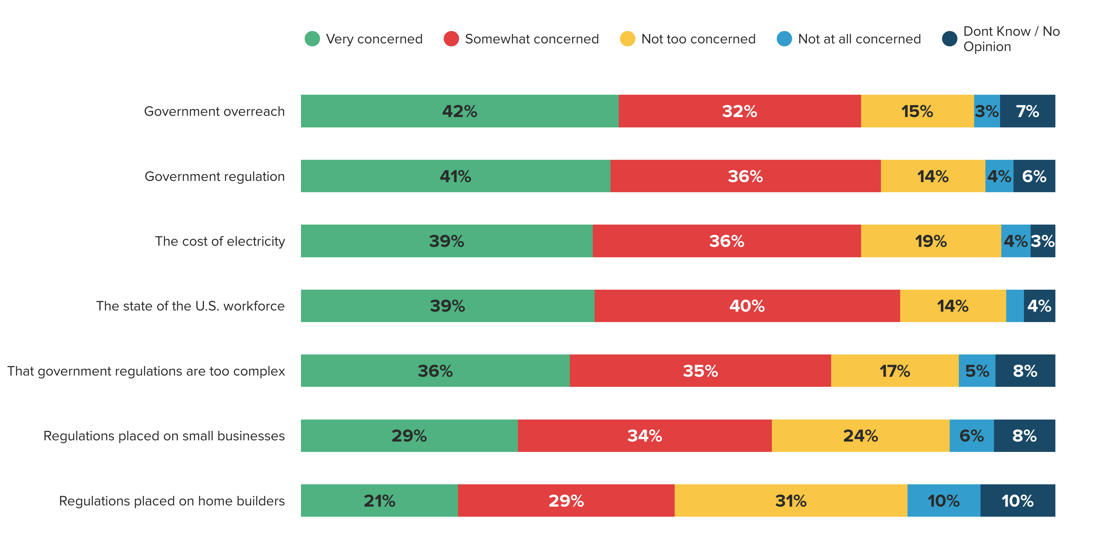
Seven in ten voters (71%) are concerned that government regulations are too complex.
How concerned are you, if at all, about the following issues?
Total Concern
74%
77%
75%
79%
71%
63%
50%
2

Slide 6
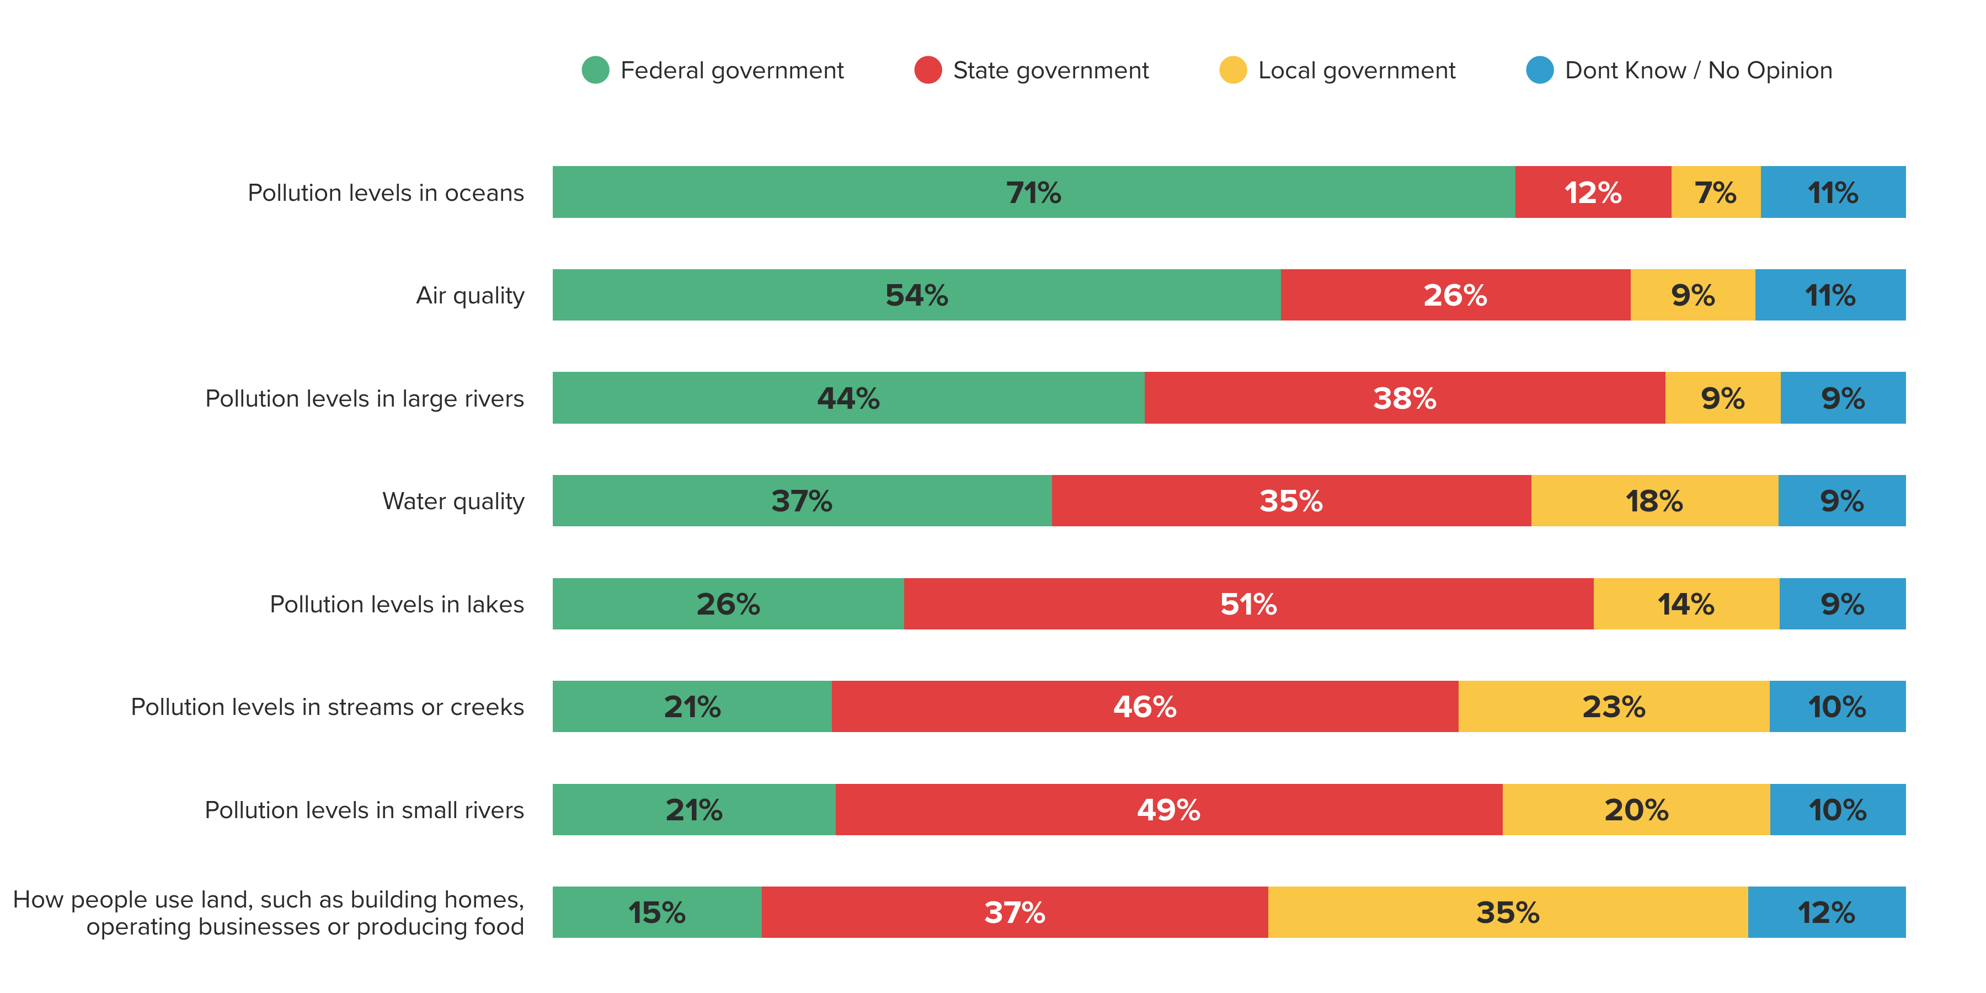
Over half (53%) say water quality should be regulated by state or local government.
Which level of government should be most responsible for regulating each of the following?
3

Slide 7
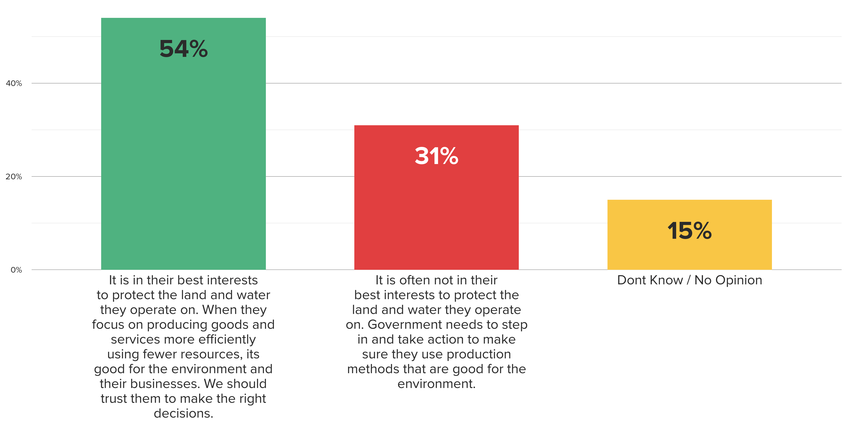
By 23-point margin, majority of voters say businesses that directly utilize land should be trusted to
make the right environmental decisions.
Which of the following statements comes closest to your view, even if neither is exactly right? Generally, when it comes to businesses that directly utilize land, such as farmers, home builders and utility companies...
23%
4

Slide 8
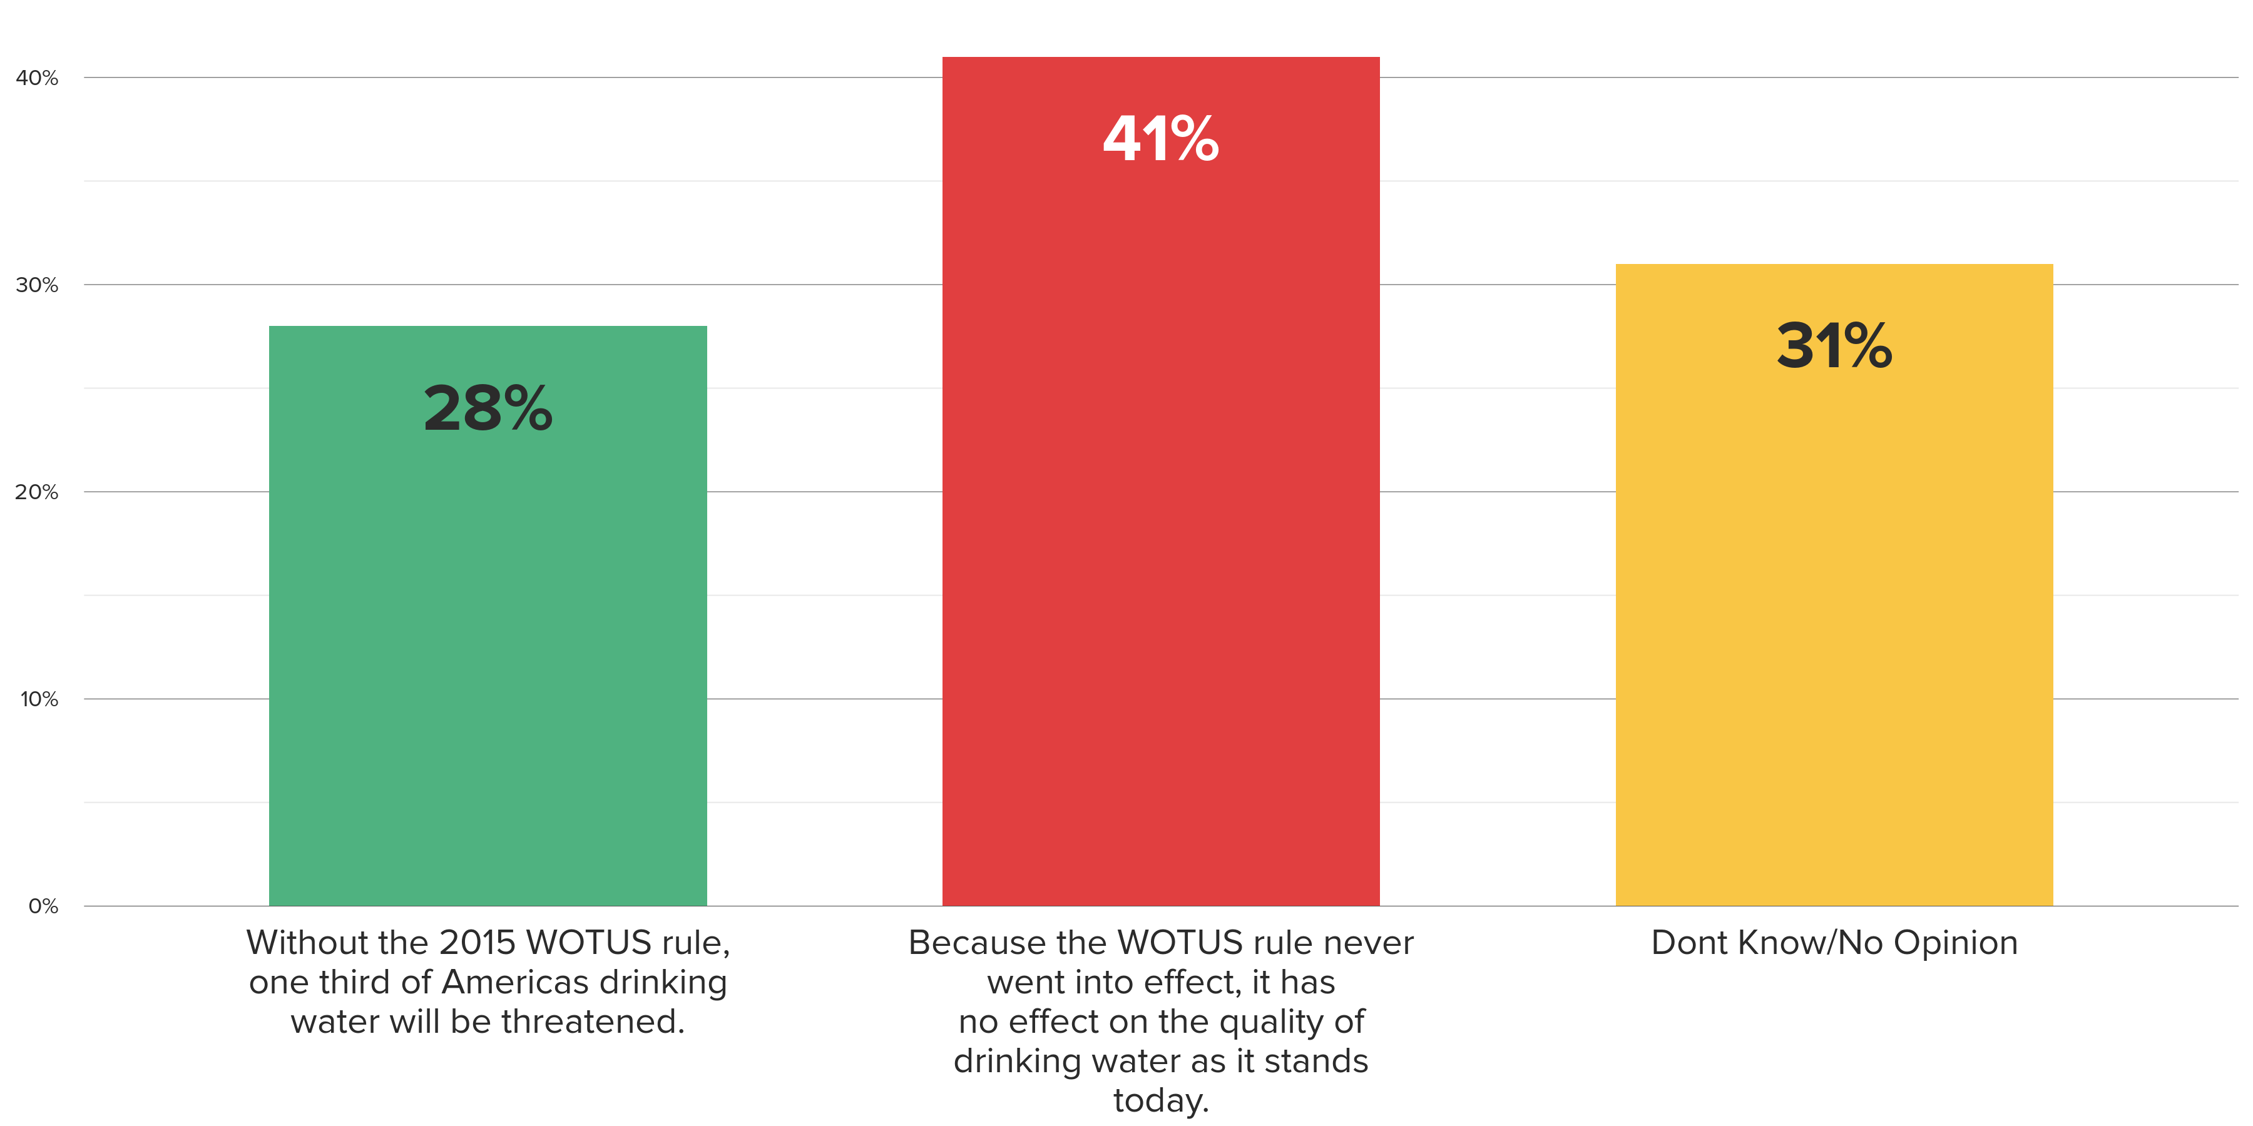
When voters learn WOTUS never went into effect, they find this argument more convincing than the claim that without WOTUS,
one-third of America’s drinking water will be threatened.
As you may know, the 2015 WOTUS rule was never implemented nationwide after a federal court blocked the rule over concerns with its legality. Knowing this, which of the following do you agree with more, even if neither is exactly right?
13%
5

Slide 9
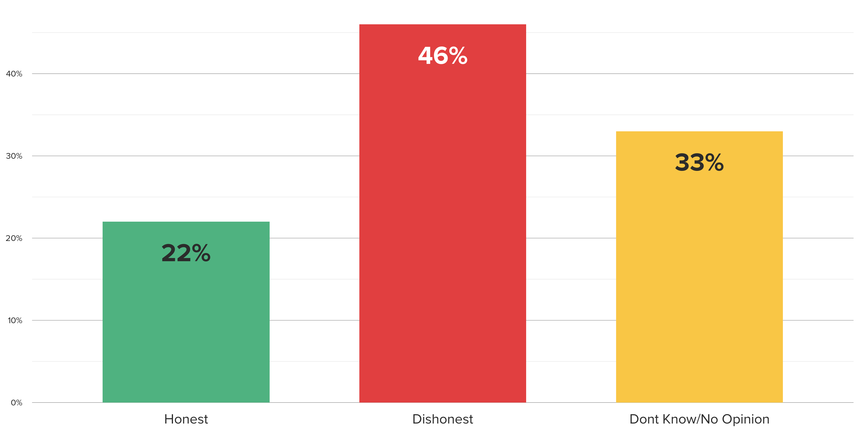
Strong plurality say claims by environmental protection groups that farmers, small businesses are in favor of dirty drinking water are dishonest.
As you may know, some environmental protection groups claim opponents of the 2015 WOTUS rule, such as farmers and small businesses, are in favor of dirty or contaminated drinking water. Knowing this, would you say this claim by environmental protection groups is honest or dishonest?
24%
6

Slide 10
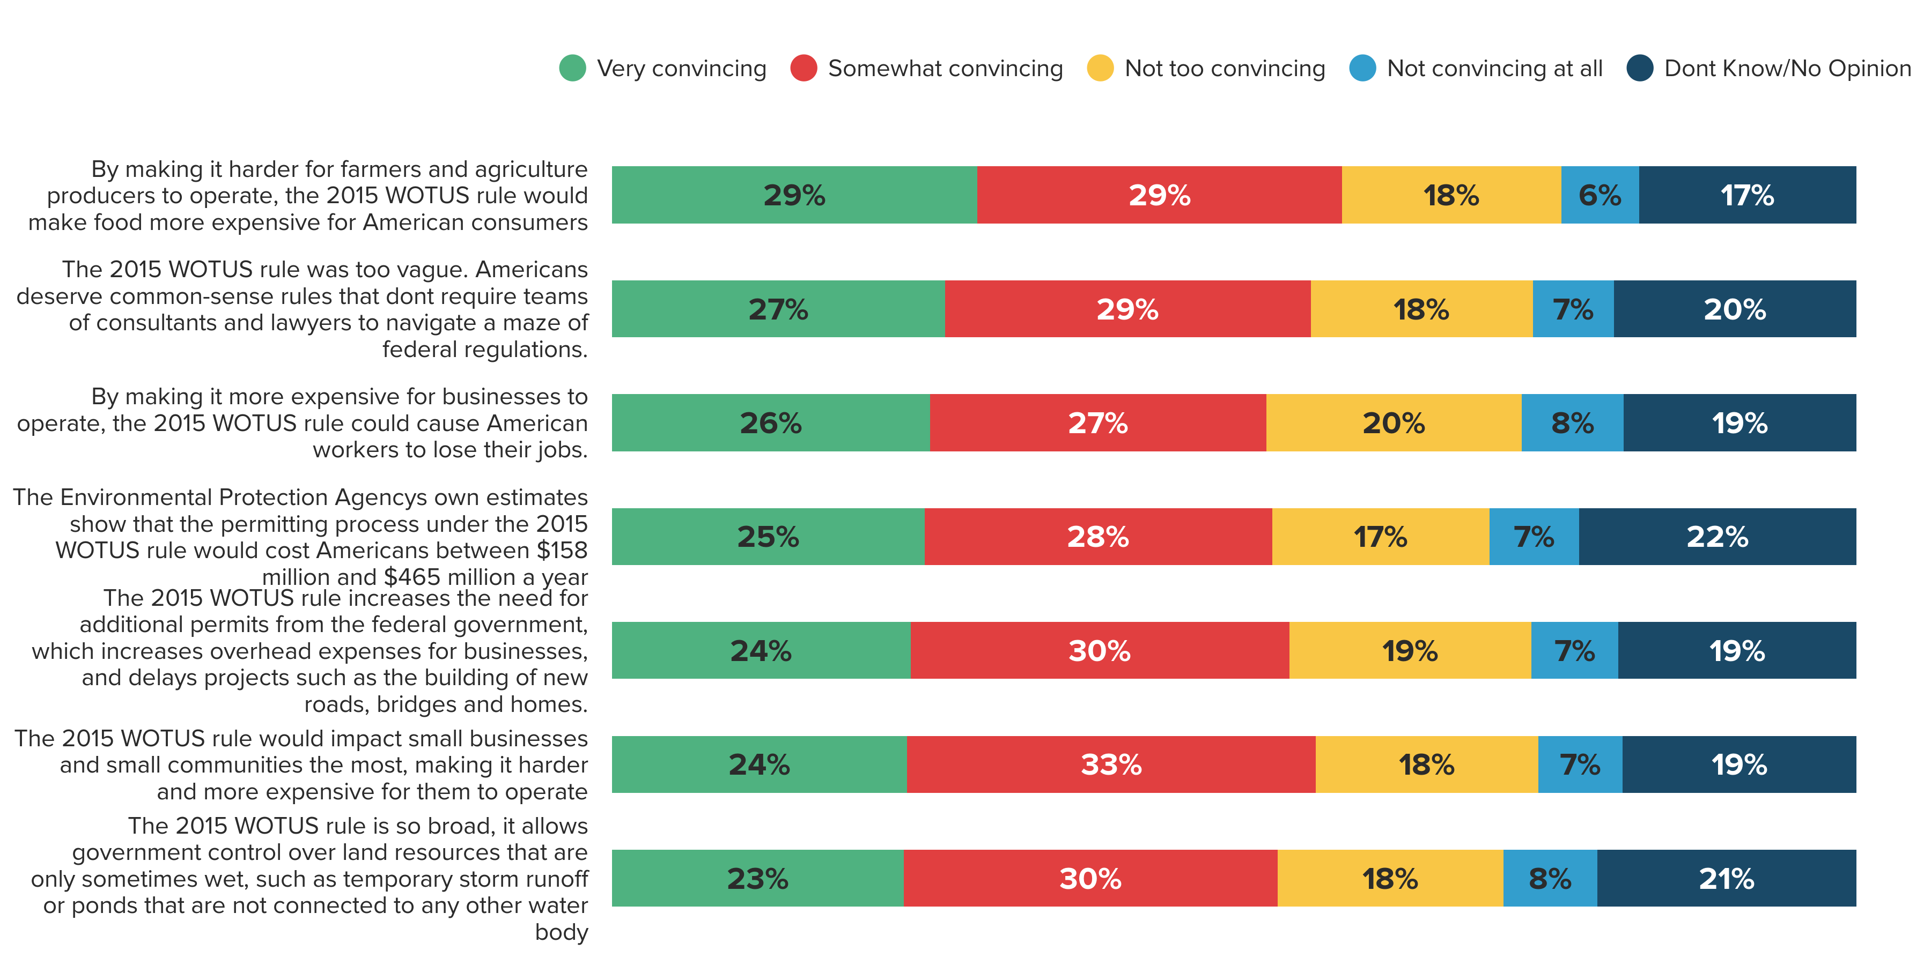
Messages related to WOTUS raising the cost of food, as well as the vagueness of rule, are most convincing to voters.
Below are arguments some have made for and against the 2015 WOTUS rule. Please indicate how convincing you find each of the following.
Total Convincing
58%
56%
53%
53%
54%
57%
53%
7

Slide 11
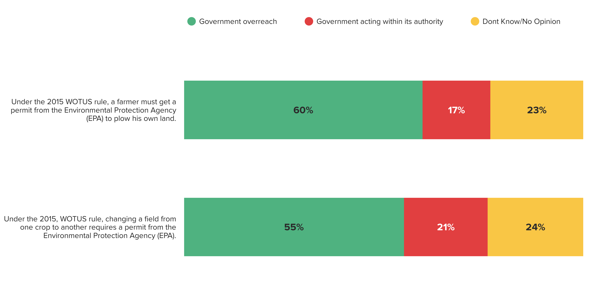
When provided examples of WOTUS in action, strong majorities recognize the act as an example of government overreach.
Do you believe each of the following are more examples of government overreach, or more examples of government acting within its authority?
9

Slide 12
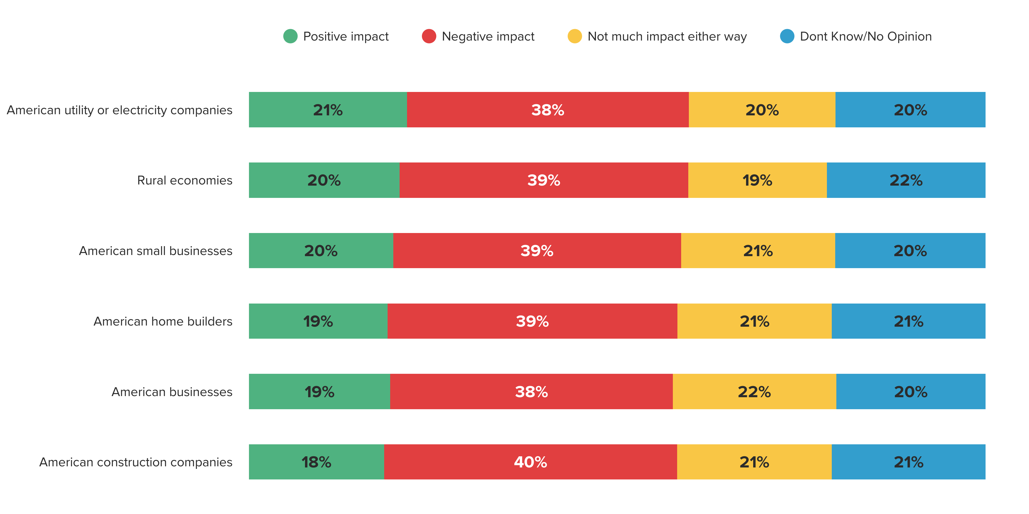
By a 2-1 margin, strong plurality of voters predict WOTUS will have negative impact across economic entities.
Based on what you know, do you believe the 2015 WOTUS rule would have a positive impact, a negative impact, or not much impact either way on each of the following?
10

Slide 13
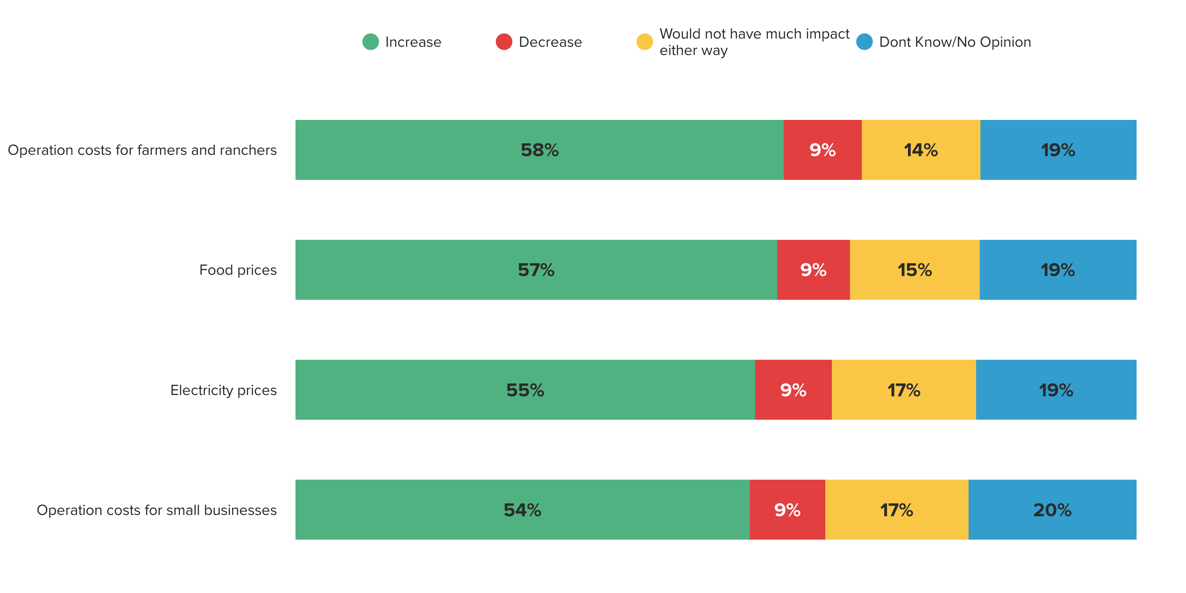
Strong majorities predict WOTUS would cause operation costs, as well as food and electricity prices to increase.
And, do you believe the 2015 WOTUS rule would cause each of the following to increase, decrease, or would it not have much impact either way?
11

Slide 14
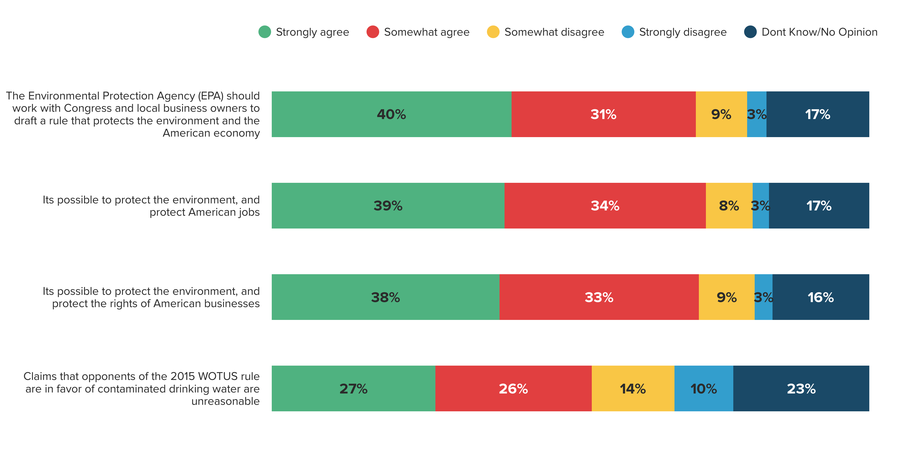
Overwhelming majority (71%) say EPA should work with Congress and local business owners to draft a new rule that protects the
environment and the economy.
Do you agree or disagree with the following statements?
Total Agree
71%
73%
71%
53%
12

